Slide 1
Data Mining for Business Analytics
Lecture 2: Introduction to Predictive Modeling Stern School of Business New York University Spring 2019

Slide 2


Classification and class probability estimation
?

Slide 3

Regression
How much will customer X spend?

Slide 4

Similarity Matching
We ran out of that.
Would you like to try … ?

Slide 5
Clustering

Slide 6
Co-occurrence Grouping

Slide 7




Profiling (“typical” behavior description)
VS

Slide 8
Data Reduction

Slide 9
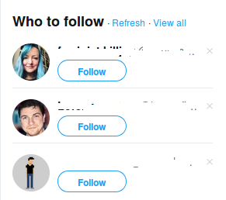
Link Prediction

Slide 10

Causal Modeling

Slide 11
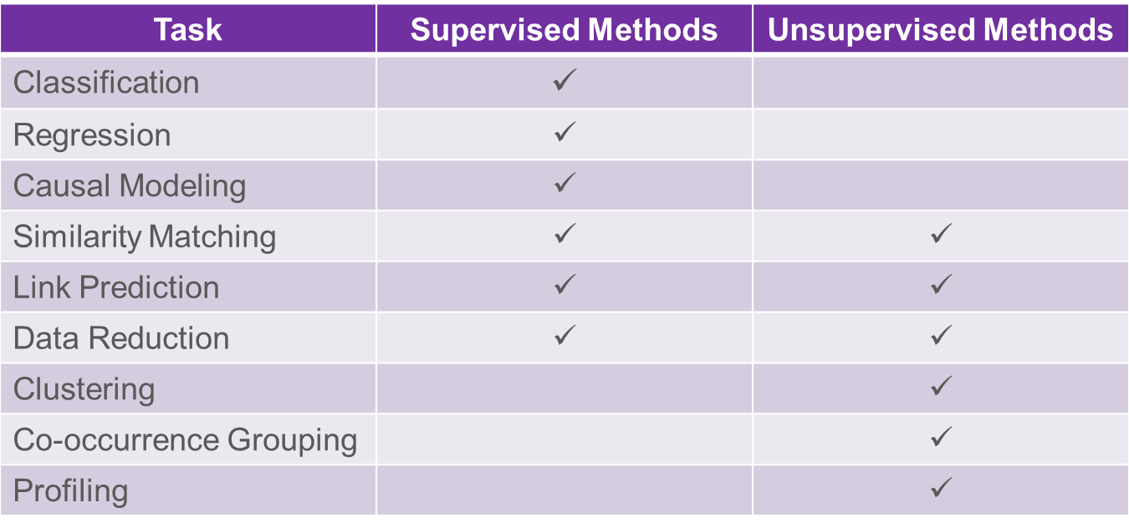
Supervised versus Unsupervised Methods

Slide 12
Supervised Data Mining & Predictive Modeling
Is there a specific, quantifiable target that we are interested in or trying to predict?
Think about the decision
Do we have data on this target?
Do we have enough data on this target?
Need a min ~500 of each type of classification
Do we have relevant data prior to decision?
Think timing of decision and action
The result of supervised data mining is a model that predicts some quantity
A model can either be used to predict or to understand

Slide 13
Terminology
Model:
A simplified representation of reality crated to serve a purpose
Predictive Model:
A formula for estimating the unknown value of interest: the target
The formula can be mathematical, logical statement (e.g., rule), etc.
Prediction:
Estimate an unknown value (i.e. the target)

Slide 14
Terminology
Instance / example:
Represents a fact or a data point
Described by a set of attributes (fields, columns, variables, or features)
Model induction:
The creation of models from data
Training data:
The input data for the induction algorithm

Slide 15
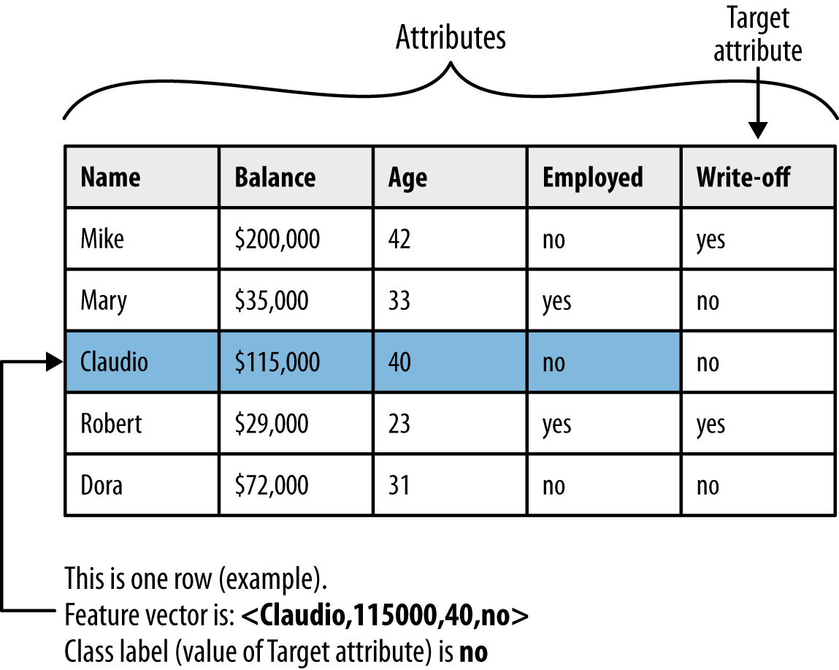
Terminology (in Pictures)

Slide 16
MegaTelCo – Our First Job !
You just landed a great analytical job with MegaTelCo, one of the largest telecommunication firms in the US
They are having a major problem with customer retention in their wireless business
In the mid-Atlantic region, 20% of cell phone customers leave when their contracts expire. Communications companies are now engaged in battles to attract each other’s customers while retaining their own
Marketing has already designed a special retention offer
Your task is to devise a precise, step-by-step plan for how the data science team should use MegaTelCo’s vast data resources to solve the problem

Slide 17
MegaTelCo – Our First Job !
What data you might use?
How would they be used?
How should MegaTelCo choose a set of customers to receive their offer in order to best reduce churn for a particular incentive budget?

Slide 18
Data Mining versus Use of the Model
“Supervised” modeling:
“Training” data have all
values specified
Model in use:
New data item has some value unknown (e.g., will she leave?)

Slide 19
Classical Pitfalls in DM setup
The training data is NOT consistent with the use
Bad sample
Bad features

Slide 20
Sample: “Looking under the streetlight”
Target Proxy
I do not see if a person after seeing an ad bought the book, so lets model clicks …
Sample Proxy
I want to run a campaign in Spain but only have data on US customers

Slide 21

Sample: Survival Bias

Slide 22
Different Sources
Things go really bad if the positive and negative are treated differently
Looking for drivers of diabetes: how do you assemble the training data?
Bad:
Go to a specialized hospital and get records from people treated for diabetes
Go somewhere else to get records for healthy people

Slide 23
Thanks!

Slide 24
Questions?

